Slide 1

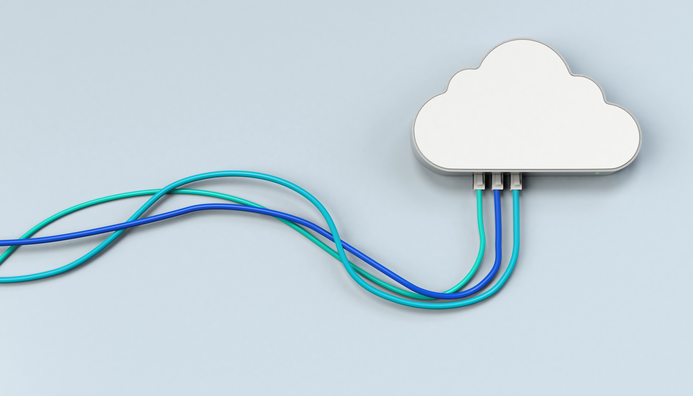

Cloud Computing 101
Notes:
Please post in the chat what your job / level of experience is or why you joined this session

Slide 2
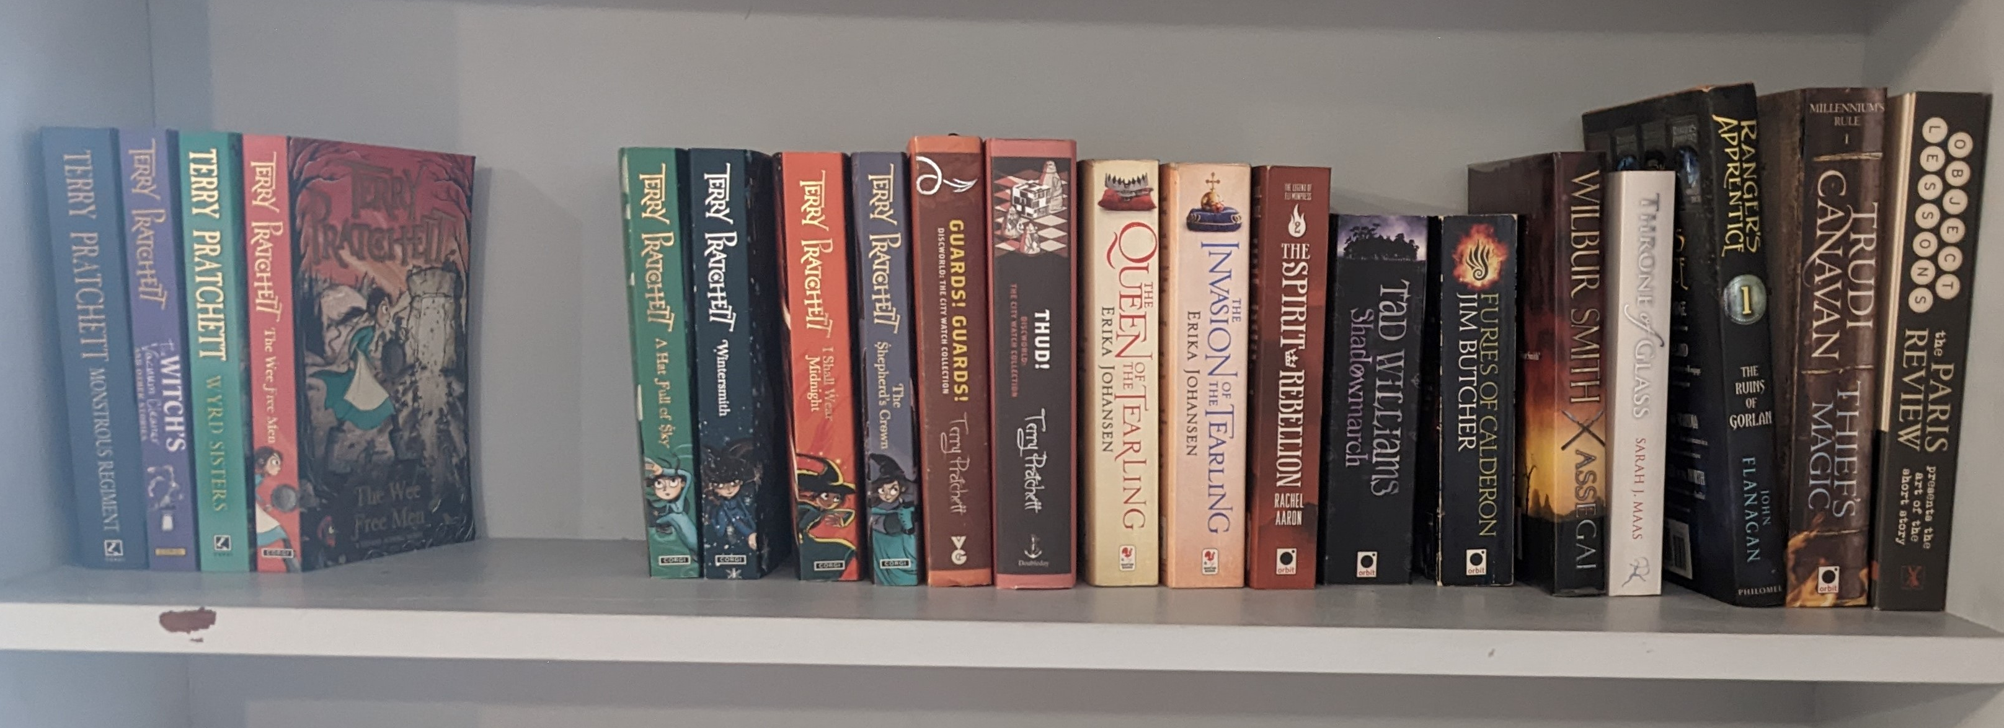
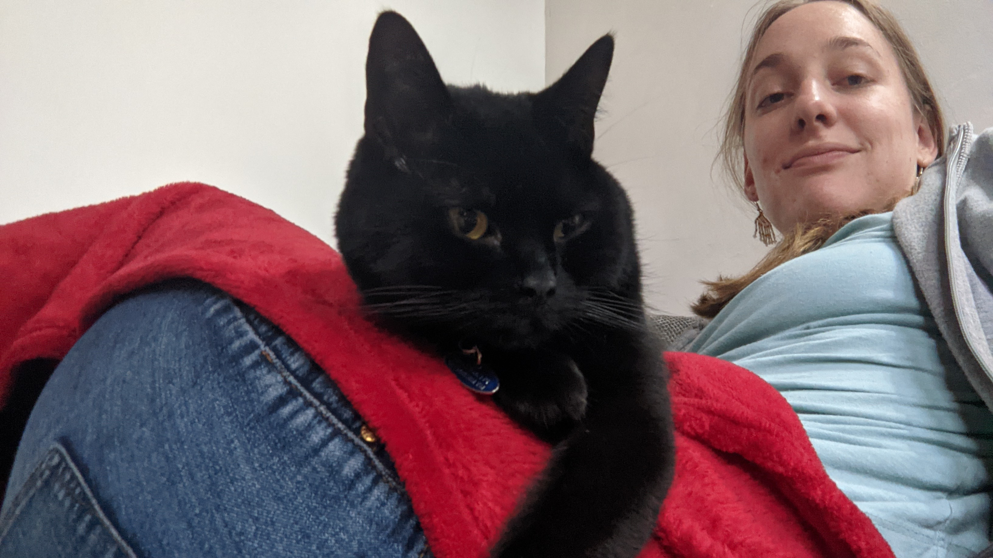
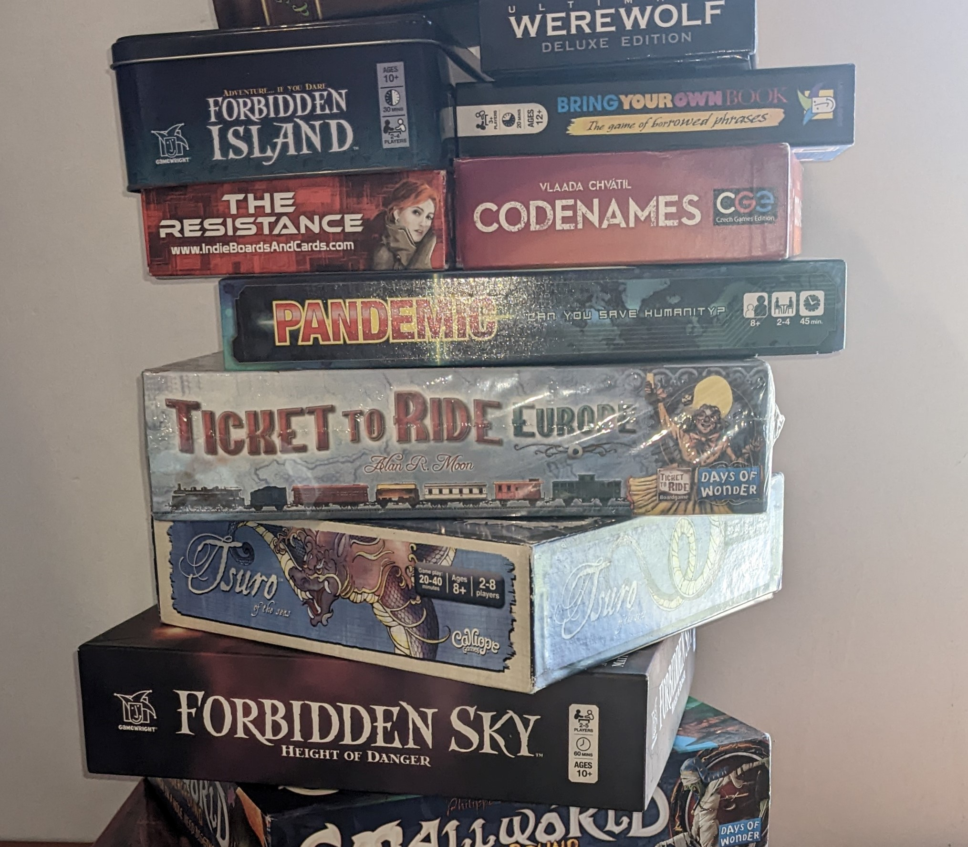
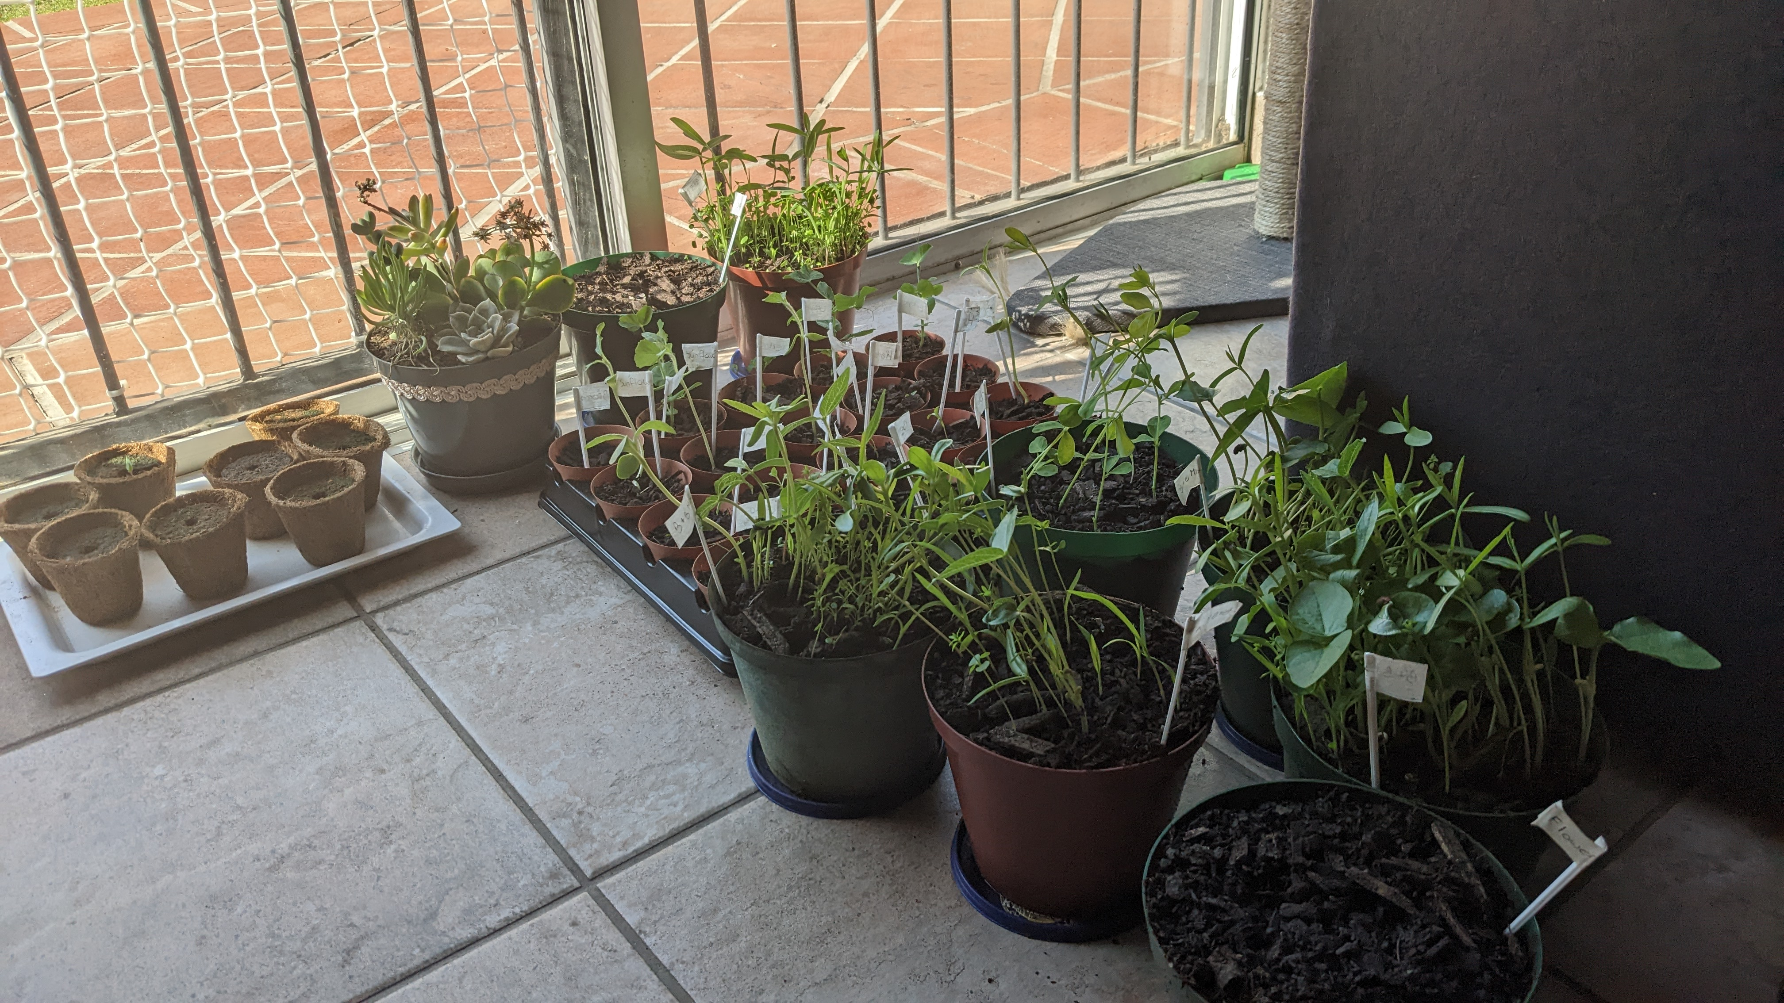
Renette Ros
Technical Lead @ Entelect

Slide 3

Discussion
Have you lost data because you didn’t have backups?

Slide 4
Content
Refresher
The story
A little bit of history
What is cloud computing?
Why cloud computing
Cloud Computing Platforms

Slide 5
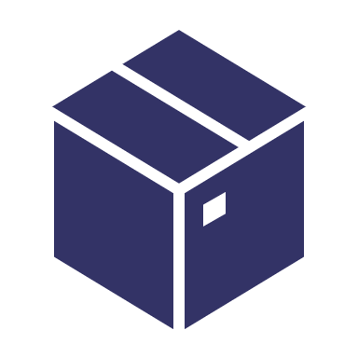
Refresher
What is Docker?
Docker is a software framework for building, running, and managing containers.

Slide 6
Refresher
What are containers?
Everything that you need to run an application packaged into its own little bundle of data

Slide 7
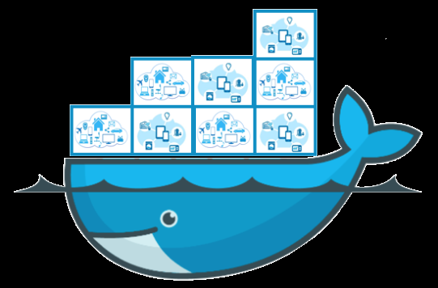
The Story
You have an application
You don’t have your own server
You put the application in a container
But… You still need to run the container somewhere
What now?
Notes:
So whats the story behind cloud computing?
You have an application that you would like to deploy somewhere so other people can start using it, but, you don’t have a server that you can deploy it on.
After last month’s meetup you realized that “Hey, containers will help. If I put my application in a container I can run it anywhere!”
The problem is that “anywhere” is still a little bit vague. Sure, I have a container now, but where can I deploy or run the container.
What now.

Slide 8
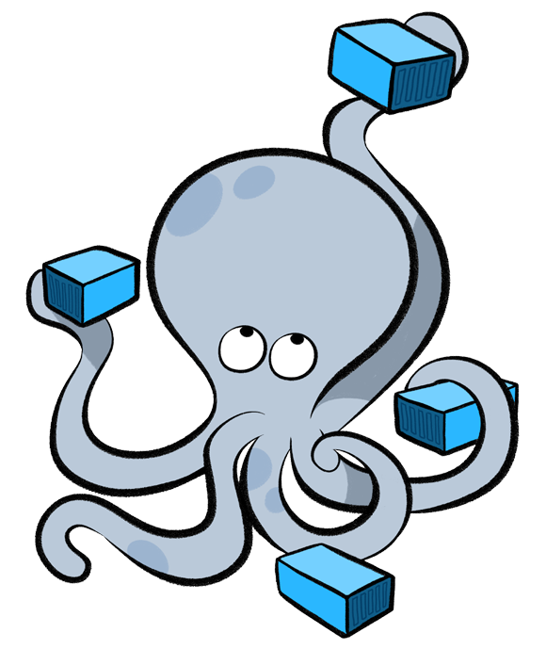
The Answer
Deploy it on someone else’s server!
Notes:
The obvious answer to those questions is …. Deploy it on someone else’s server! And if I have to say in 3 words what cloud computing is – I would say it is “Someone elses server”

Slide 9

History Time
Notes:
Before we talk about what cloud computing is and how it solves this problem… Lets take a quick side quest through history to see how the developers of the past sovled this problem!

Slide 10

History of cloud computing
Early Computers: Batch Processing
1960s: Time Sharing
1970s: IBM Virtual Machines
1990s: VPNs and Cloud metaphor
Notes:
The earliest computing model was batch processing. Machines were dedicated to specific tasks and operators would manually run or queue small programs to run. Programs were writing offline on punch cards or paper tape, submitted to the operators and they would return the output once the program finished running
In the 1960s Time Sharing started to appear. After observing that a single user would have bursts of activity followed by long pauses, some smart engineers came up with the idea of sharing a computer (specifically an IBM Mainframe) between multiple users. The time sharing mechanism eventually evolved into full blown virtual machines and in the 1970s IBM released the first Virtual Machine operating system
In the 1990s the cloud metaphor was first used to describe a network or services that users do not need to manage individually. Its just there, they don’t have to worry about it.

Slide 11
Technical Term
Virtual Machine A digital version of a physical computer

Slide 12
Technical Term
VPN - Virtual Private Network
An encrypted, private connection over the Internet

Slide 13
History (Cont’d)
2002: AWS Launched
2006: First generation AWS Services
2008: Google app engine
2010: Microsoft Azure launched
2012: Google compute engine
Notes:
The earliest computing model was batch processing. Machines were dedicated to specific tasks and operators would manually run or queue small programs to run. Programs were writing offline on punch cards or paper tape, submitted to the operators and they would return the output once the program finished running
In the 1960s Time Sharing started to appear. After observing that a single user would have bursts of activity followed by long pauses, some smart engineers came up with the idea of sharing a computer (specifically an IBM Mainframe) between multiple users. The time sharing mechanism eventually evolved into full blown virtual machines and in the 1970s IBM released the first Virtual Machine operating system
In the 1990s the cloud metaphor was first used to describe a network

Slide 14
Discussion
What does ‘cloud’ and ‘cloud computing’ mean?

Slide 15

What is Cloud Computing?
The practice of using a network of remote servers hosted on the internet to store, manage, and process data, rather than a local server or a personal computer.
- Oxford English Dictionary
Notes:
What exactly is cloud computing besides just “Someone else’s server”
Let’s start of by asking google… Searching for “What is cloud computing”, yields the following definition from the Oxford English dictionary

Slide 16
What is Cloud Computing?
Cloud computing is the on-demand delivery of IT resources over the Internet with pay-as-you-go pricing.
- Amazon Web Services
Notes:
Here is a shortened version of the definition provided by AWS. There is a slight different in the inclusion of the words ‘on demand’ and ‘pay as you go’
Instead of buying, owning, and maintaining physical data centers and servers, you can access technology services, such as computing power, storage, and databases, on an as-needed basis from a cloud provider whenever you want

Slide 17
In Plain English?
Someone else’s server(s)
Accessed through the internet
That you can use
Whenever you need

Slide 18
More than just ‘servers’
Cloud Computing Service Models
Platform as a service
Software as a service
Infrastructure as a service
Little Control
Lots of control
Notes:
I said cloud computing is deploying your things on someone else’s server, but its actually a little more complicated than that. Cloud computing is actually divided into three main ‘models’ – and even though the border is a little bit fuzzy sometimes – its all about how much control you have over the cloud hosted solution.
At the lowest level we have infrastructure as a service which means the cloud provider gives you the bare bones infrastructure but you still have to manage it.
At a slightly higher level of abstraction – but built on top of IaaS we have the idea of a Platform as a Service. More is manged by the cloud provider and you have less control but you still have a lot of flexibility.
The highest level is the Software as a service model. This is when you get software – its no longer a platform to allow you to build or deploy your own solutions.

Slide 19

Infrastructure as a service
IaaS
Notes:
Infrastructure as a service is the first cloud computing model. It has a very low level of abstraction: You will deal with virtual machines, load balancers, networking, storage. All the things you would still need to deal with if you had your own server or datacenter, except its in the cloud now.
Lets use a real life analogy to try and explain the different between the three models: The problem we are trying to solve is “We need a house”. In infrastructure as a service, the cloud provider would be giving us a bunch of construction materials and telling us “Here, you build it”
“What do we mean by service? Explain technical terms
TODO: Explain what is infrastructure, Make slides for individual examples!!!

Slide 20
Technical Term
Infrastructure
A foundation or framework that supports a system or organization.

Slide 21
Infrastructure as a service
IaaS
Virtual Machines
Load Balancers
Firewall
Storage
Notes:
Infrastructure as a service is the first cloud computing model. It has a very low level of abstraction: You will deal with virtual machines, load balancers, networking, storage. All the things you would still need to deal with if you had your own server or datacenter, except its in the cloud now.
Lets use a real life analogy to try and explain the different between the three models: The problem we are trying to solve is “We need a house”. In infrastructure as a service, the cloud provider would be giving us a bunch of construction materials and telling us “Here, you build it”
“What do we mean by service? Explain technical terms
TODO: Explain what is infrastructure, Make slides for individual examples!!!

Slide 22

Virtual Machine
Software that emulates a physical computer
Notes:
Software that emulates a physical computer / A digital version of a physical computer

Slide 23
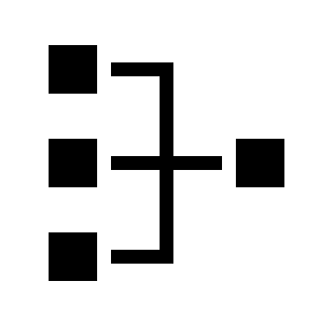
Load Balancer
A tool that distributes traffic across several servers
Notes:
Software that emulates a physical computer / A digital version of a physical computer

Slide 24

Firewall
A security system that monitors and controls incoming and outgoing network traffic
Notes:
Software that emulates a physical computer / A digital version of a physical computer

Slide 25
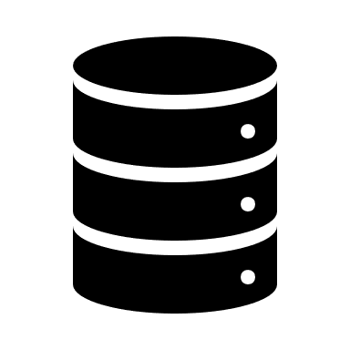
Storage
A way of storing data
e.g. Hard Drives
Notes:
When we talk about storage in cloud computing, we are still talking about storing your data. In the non-cloud world that could mean a hard drive, flash drive or external drive. In the world of cloud computing it’s the same thing – except its virtual: It looks like a physical hard drive to our servers, but its actually emulated by software.
When we talk about cloud solutions, you might here things like blob storage, block storate,

Slide 26
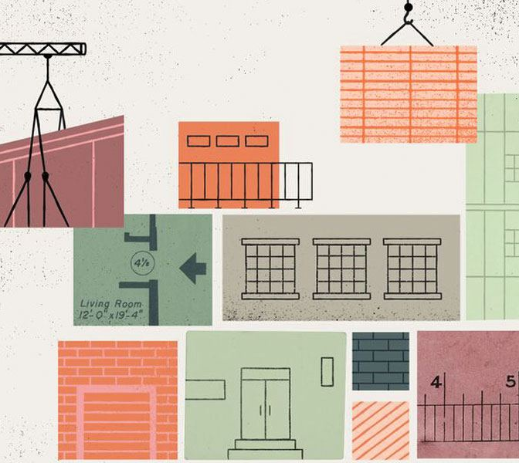
Platform as a service
PaaS
Database
Container orchestration
Application Runtime
Web server
Serverless
Networks
Notes:
At a level slightly higher than Infrastructure as a Service, our cloud computing platforms can also provide “Platforms as a Service”
As a backend application developer, this is the level of abstraction that makes me happy: I don’t have to deal with the bare metal things, but it is still flexible enough to allow me to build and deploy your custom applications.
You don’t need to worry about patching the operating system or software, and if you want to scale you do not need to worry about setting up additional servers, configuring the network things and all the other extra work. You can just scale, and automatic scaling might even be available.
If we go back to the house analogy, this would be more like building a modular home. The cloud provider gives us a bunch of different modules for different rooms / sections and we just need to put them together the way you want. It’s a lot faster, but we have slightly less control and flexibility.
TODO: Separate slides for examples

Slide 27
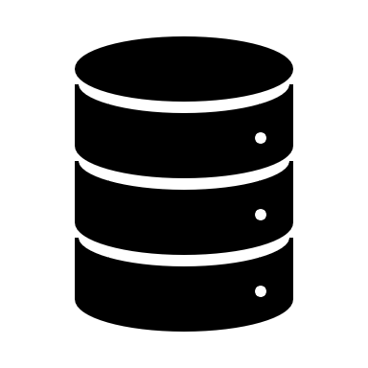
Database
An organized collection of data stored and accessed electronically
e.g. SQL Server, MongoDB, PostgreSQL
Notes:
Software that emulates a physical computer / A digital version of a physical computer

Slide 28

Container orchestration
Automates the deployment, management, scaling, and networking of containers
Notes:
Software that emulates a physical computer / A digital version of a physical computer

Slide 29
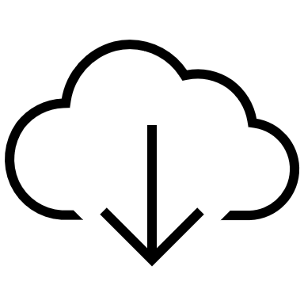
Web Servers
Just upload your website files, the server is managed for you
e.g. Apache
Notes:
Software that emulates a physical computer / A digital version of a physical computer

Slide 30

Serverless Platforms
You do not need an entire server to run your code
e.g. Aws Lambda, Azure Functions
Notes:
Software that emulates a physical computer / A digital version of a physical computer

Slide 31
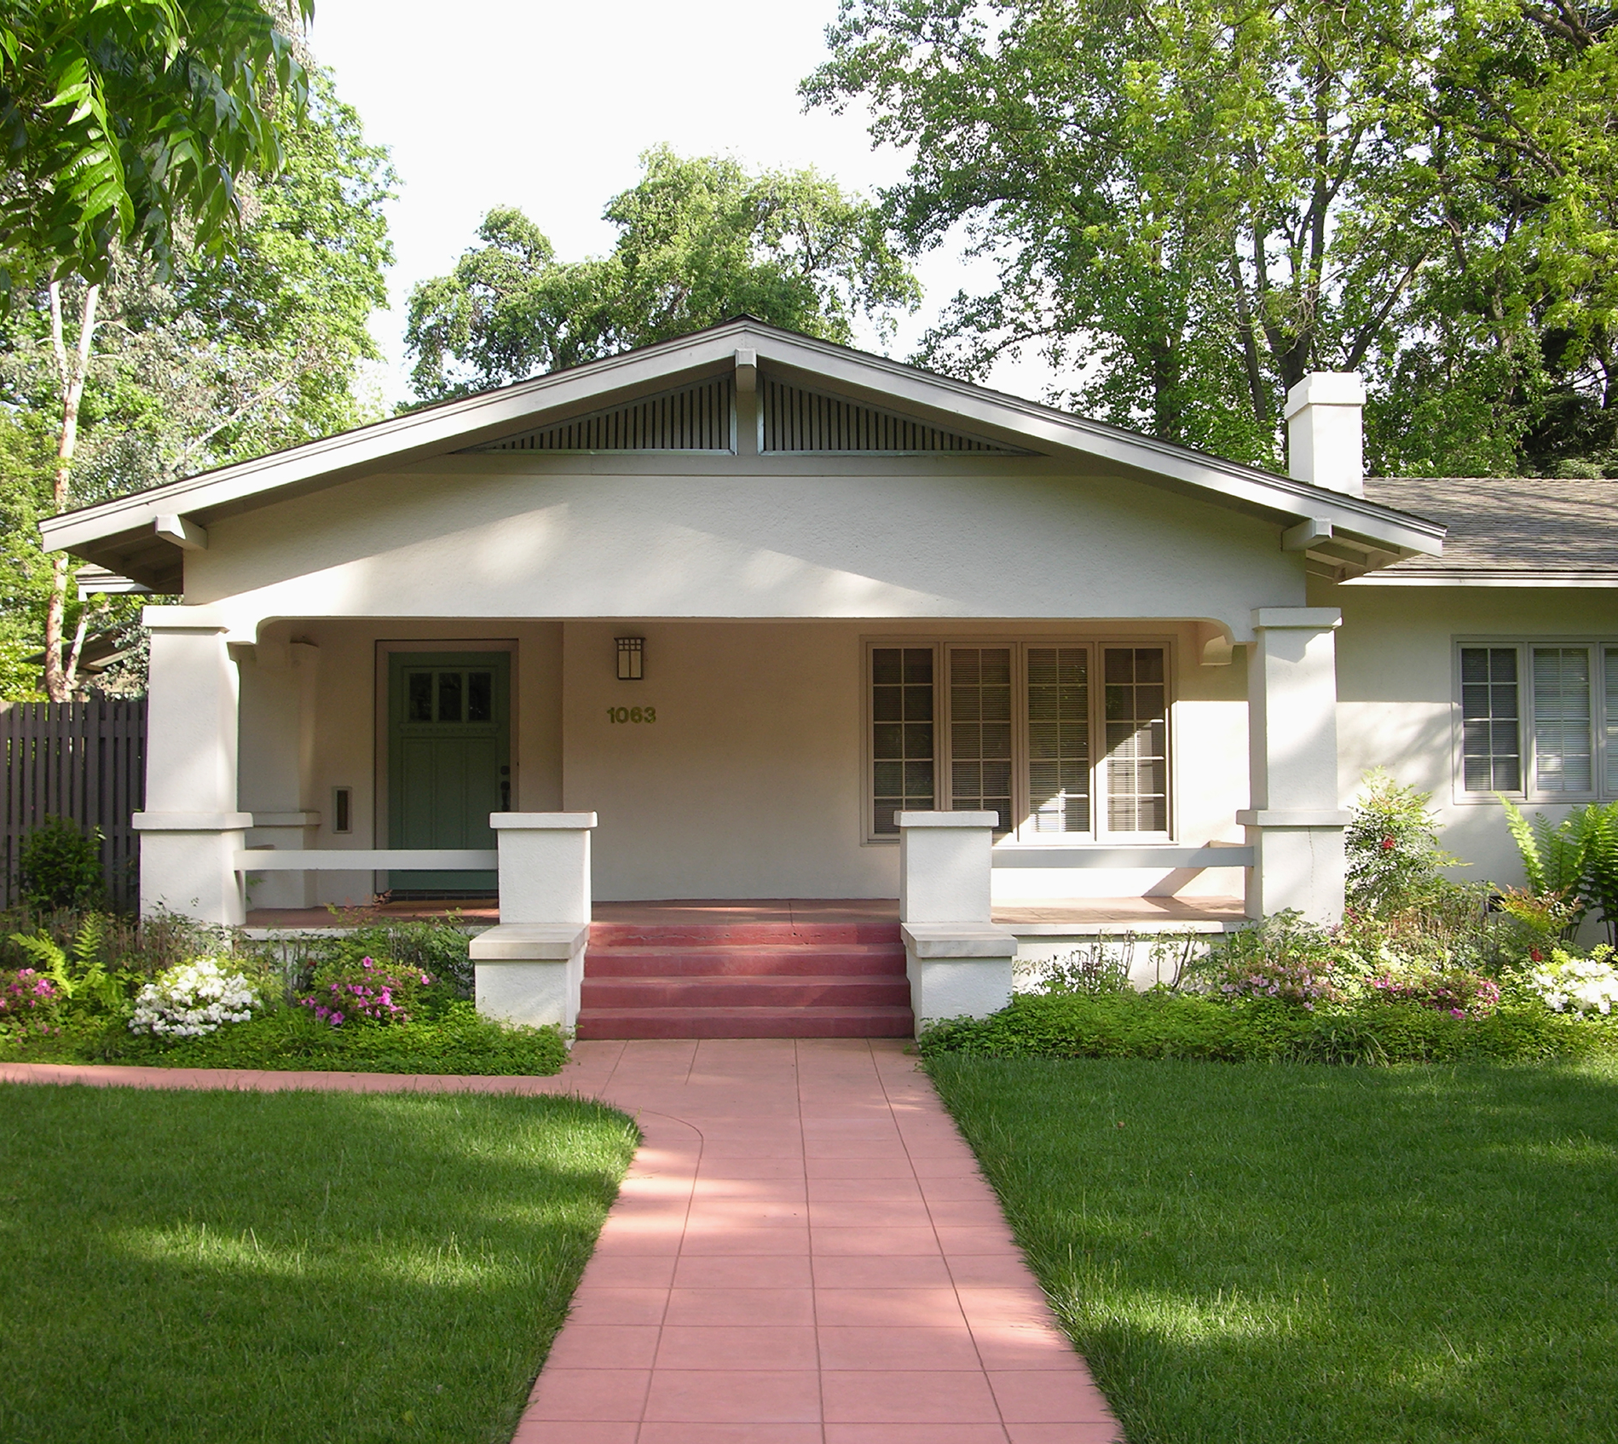
Software as a service
SaaS
Google Drive & Docs
Microsoft Office Online
Microsoft Teams
Slack
Discord
Notes:
At the highest level of our little pyramid, we have software as a service. A lot of the time these services don’t even feel like cloud! When I think about cloud computing I think about Azure and Aws, not Slack or Google docs.
Instead of providing an infrastructure or platform for you to build your software on, the cloud platform provides you with the dedicated software.
If we go back to the house analogy: Here we do not even need to build a house – the cloud provider can just rent one to us!. In this case we have the lowest level of control but also the least responsibility
TODO: Demo

Slide 32
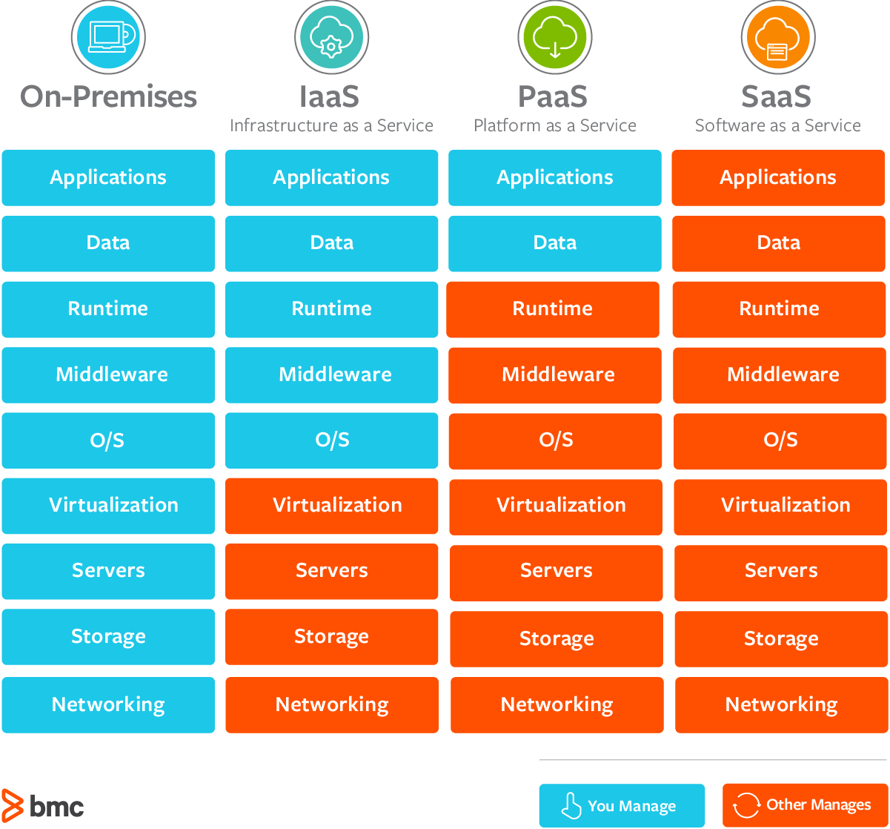
Summary

Slide 33
Excercise
Group the list of services into Infrastructure, Platform or Software as a Service
Notes:
No googling
Categorize things
Case study

Slide 34
Services
AWS EC2
Azure Functions
Elastic Beanstalk
RedHat OpenShift
Dropbox
Google Docs
Microsoft Office Online
Spotify
Netflix
Gmail
Slack
Discord
Heroku
Google App Engine
Digital Ocean
Aws RDS
Google Compute Engine
WordPress
IBM Cloud Foundry
AWS Block Storage
Azure page blobs
AWS S3
Azure Cosmos DB

Slide 35
IaaS
AWS EC2
Digital Ocean
Google Compute Engine
AWS Block Storage
PaaS
Azure Functions
Elastic Beanstalk
RedHat OpenShift
Heroku
AWS RDS
IBM Cloud Foundry
Google App Engine
AWS S3
Azure Cosmos DB
SaaS
Dropbox
Google Docs
Microsoft Office Online
Spotify
Netflix
Gmail
Slack
Discord
WordPress

Slide 36
Deployment Models
Public
Private
Hybrid

Slide 37

Why Cloud?
Reduce fixed expenses
On demand scaling
Flexibility
Lower maintenance cost
High availability
Global
Notes:
Ask audience
So why would you go cloud instead of buying your own server?
Reducing fixed expensives: Instead of paying for an entire server or datacenter you can now pay only for the services you need
On demand scaling: You do not have to scale everything up front to handle high load periods or to make sure you have enough space for backups
Flexibility: Instead of spending time worrying about infrastructure and configurations , you can build things faster by using managed services.
Less responsibility: Because you have less responsibility for managing infrastructure you can spend more time and money on important things
High availability: Cloud computing platforms promise very little downtime
The big cloud platforms are global and you can easily deploy your applications in multiple regions across the world

Slide 38
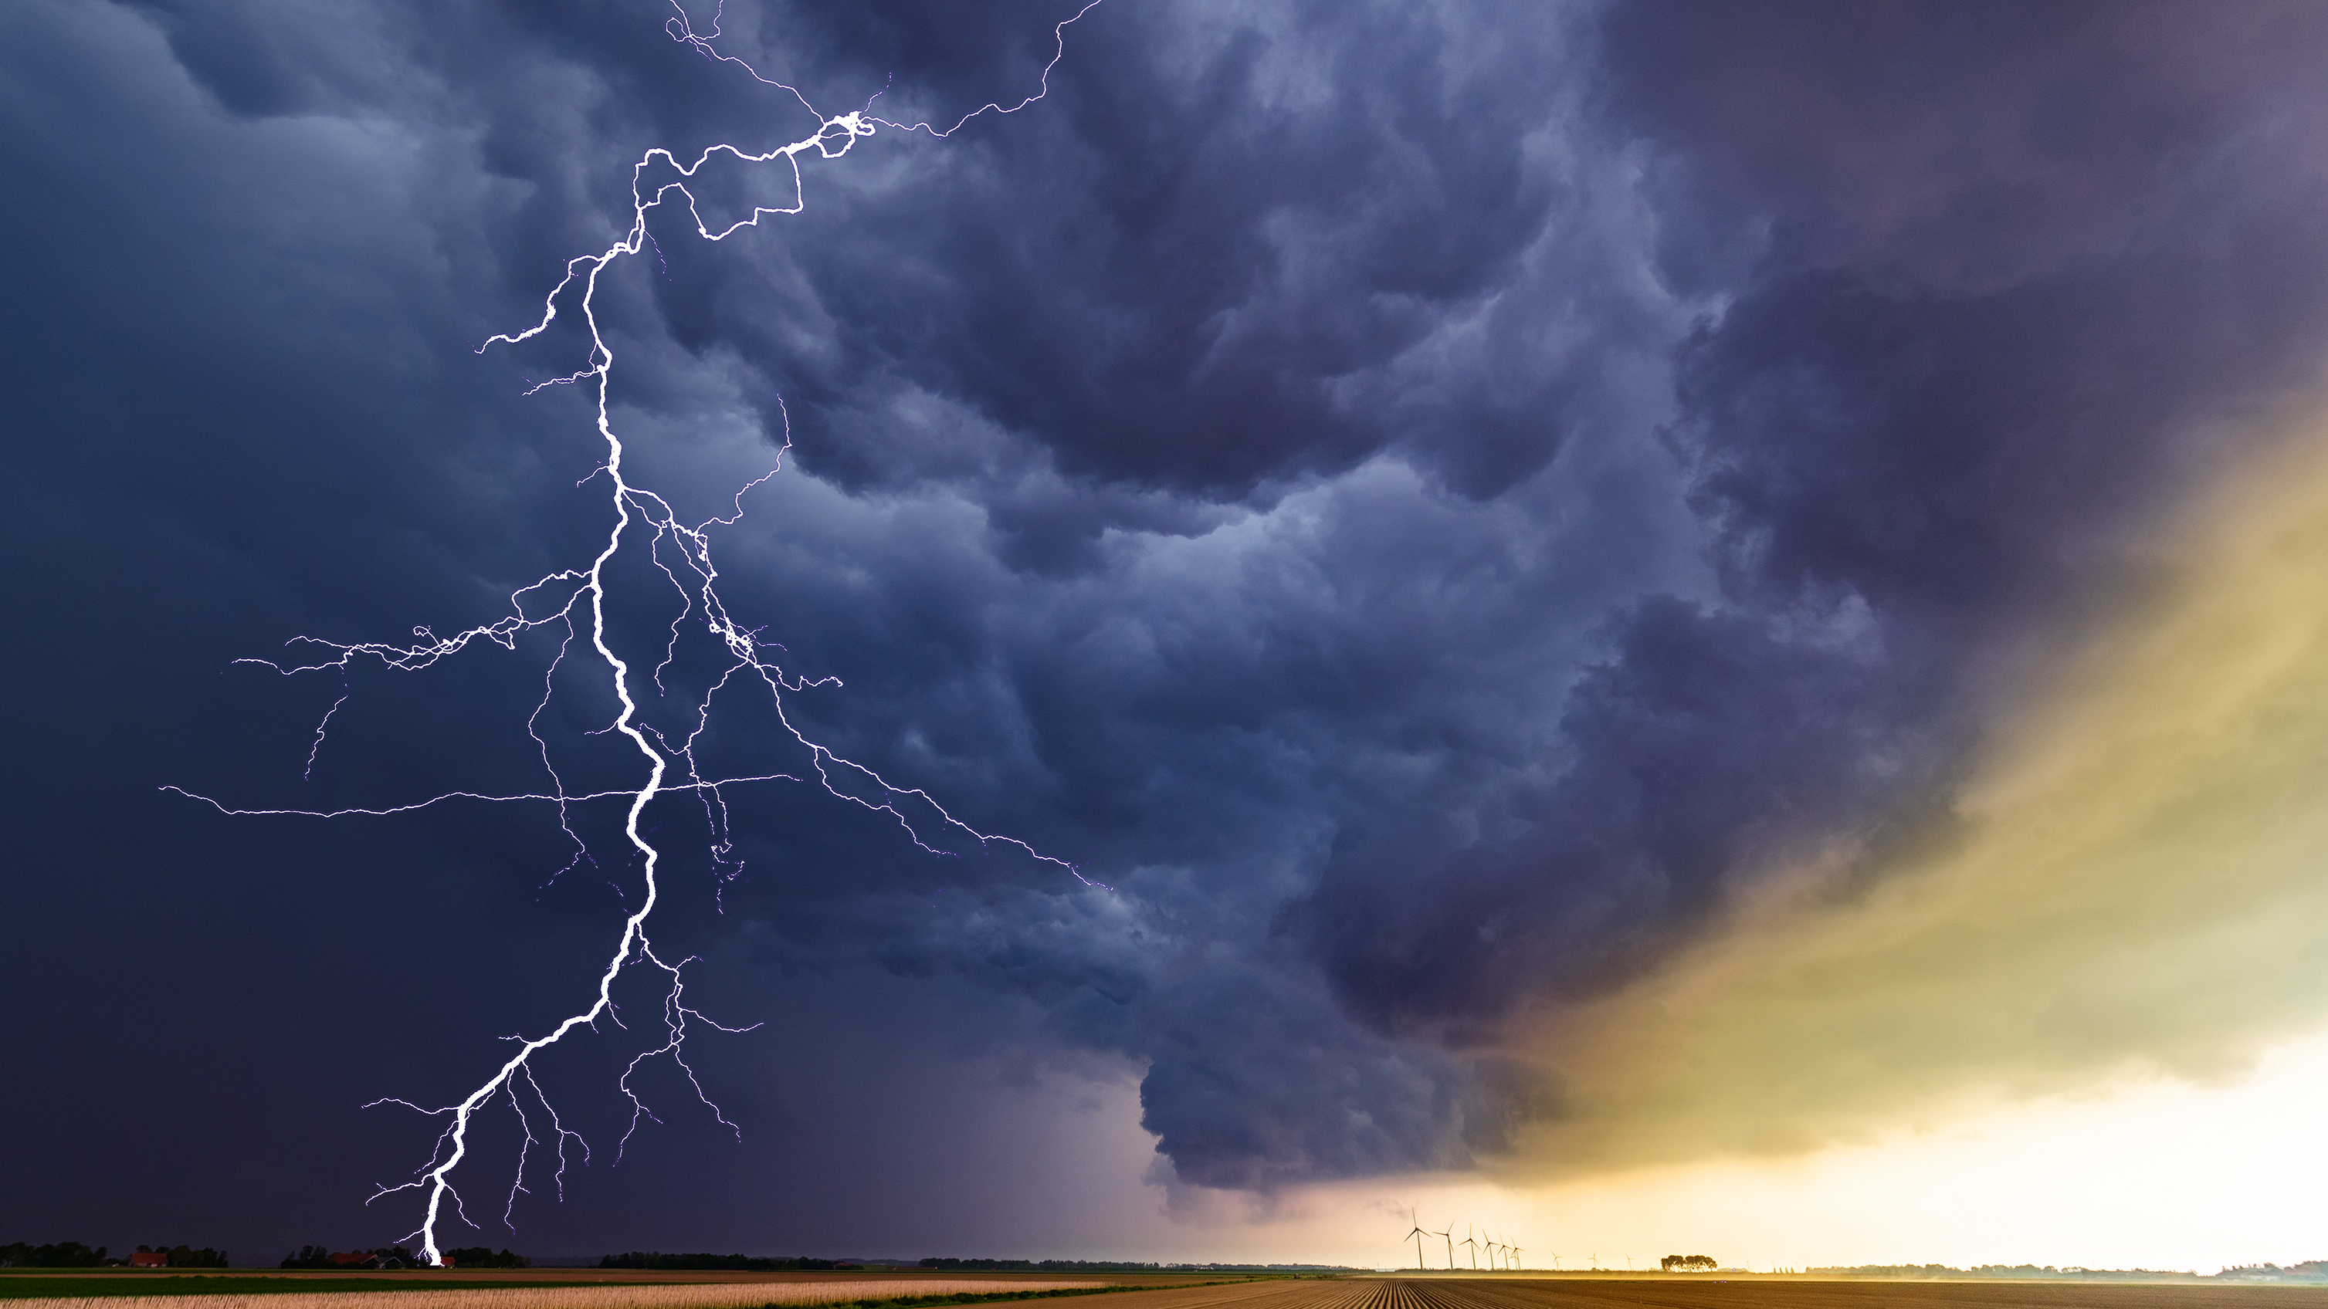
Why Not?
Less control
Security
Unexpected costs
Vendor lock in
Data Loss
Shared Resources
Notes:
Ask audience

Slide 39
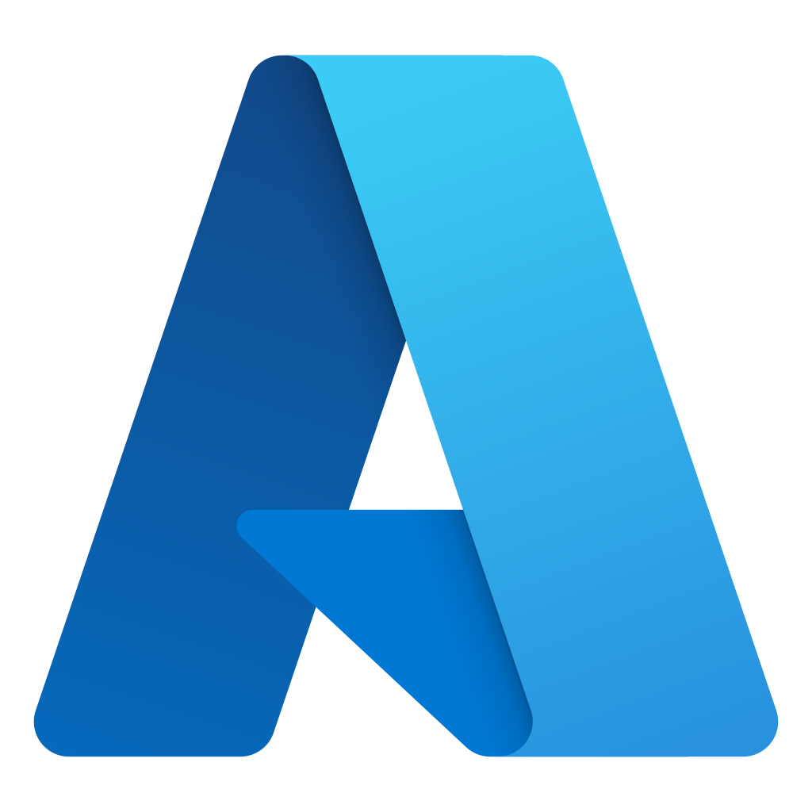
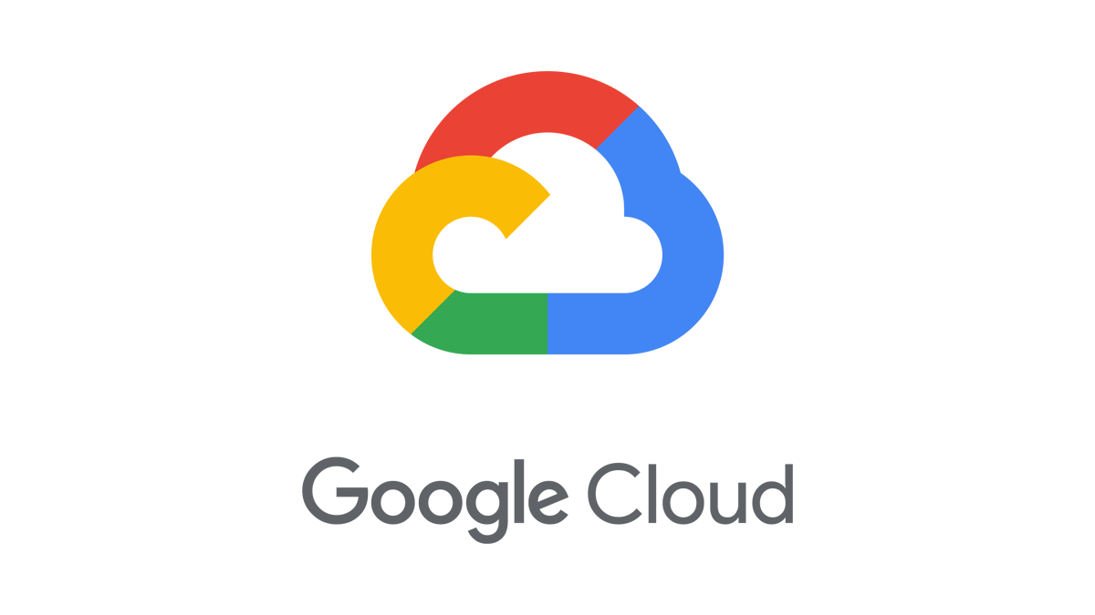

What are our options?
The big cloud computing platforms
Notes:
Ask audience
We have talked about what cloud computing is and why we would want to (or not want to) use it… Now lets look at what are options are for starting out with cloud computing and how we can get started. I am focusing on cloud providers that have Infrastructure and Platform offerings – not software as a service offerings.
There are multiple cerifications for each of these platforms. Also lots of free tutorials . Will share resources at the end of the presentation.

Slide 40
Comparison
 | AWS | GCP | Azure
Free Credits |  | $300 / 90 Days | $200 / 30 Days
Trial Period | 12 Months, 30+ services |  | 12 Months, 28 services
Always Free | 39 Services | 20+ services | 40+ services
Services | 200+ services | 200+ services | 100+ services
Regions | 27 | 27 | 34
https://azure.microsoft.com/en-us/free/free-account-faq/#free-services
https://cloud.google.com/free
https://aws.amazon.com/free/

Slide 41
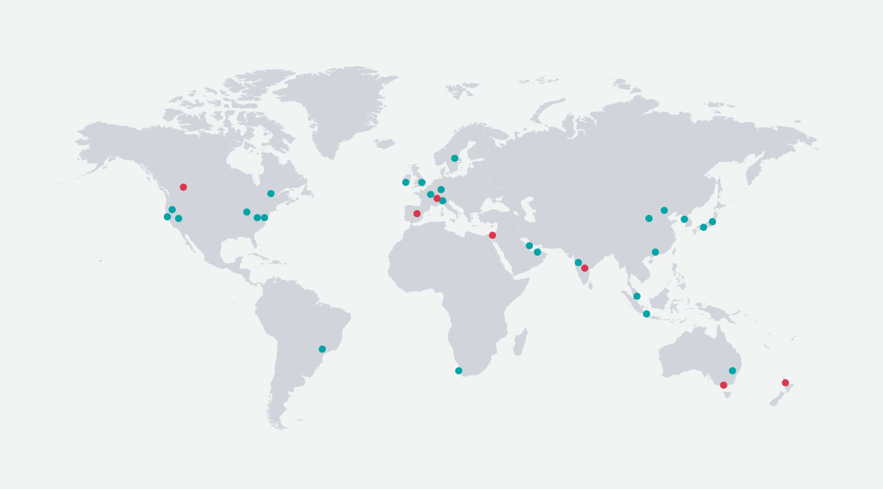
AWS Regions

Slide 42
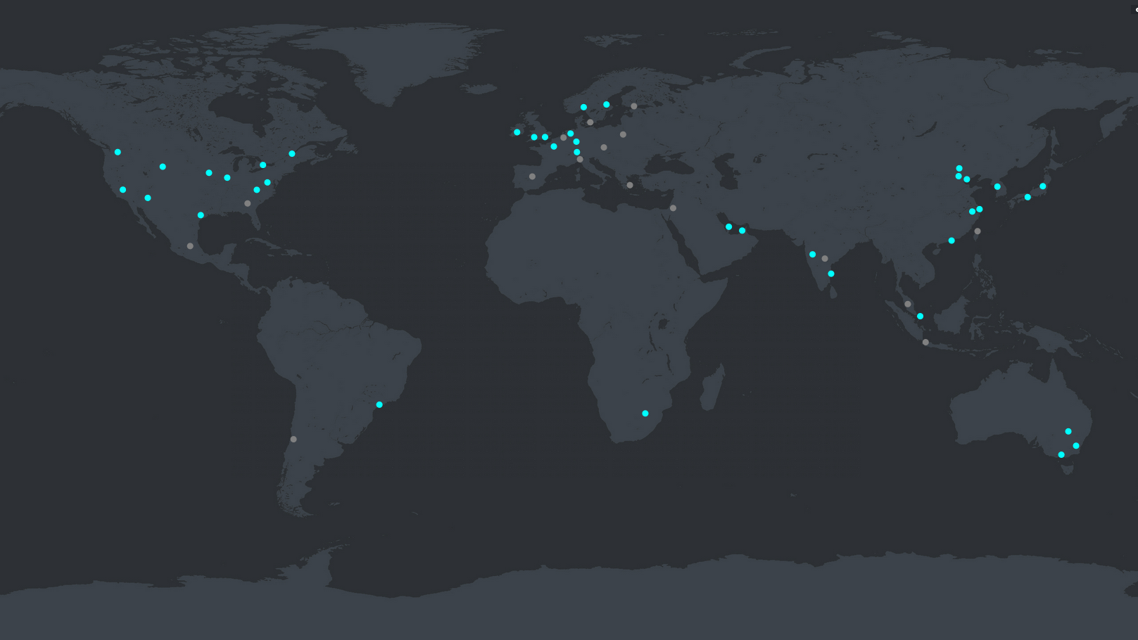
Azure Regions

Slide 43
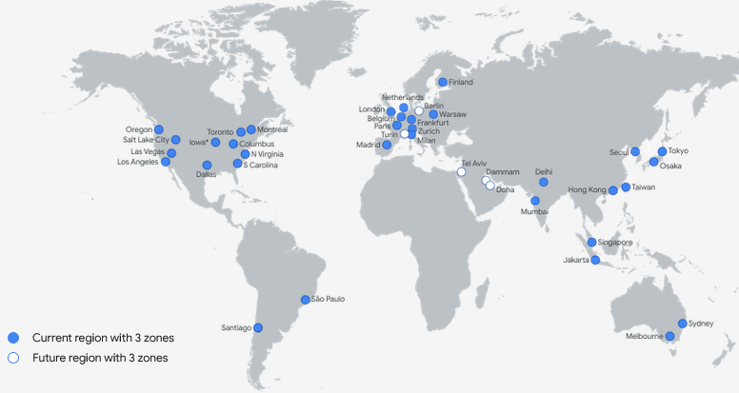
GCP Regions

Slide 44
Certifications
AWS https://aws.amazon.com/certification/
Azure https://learn.microsoft.com/en-us/certifications/
GCP https://cloud.google.com/certification

Slide 45
Official Resources
AWS https://aws.amazon.com/getting-started/hands-on/
Azure https://azure.microsoft.com/en-us/get-started/
GCP https://cloud.google.com/docs/open-tutorials

Slide 46
More Resources
https://www.tutorialspoint.com/
https://www.udemy.com/
https://www.pluralsight.com
https://www.baeldung.com

Slide 47
Demo Time!
Notes:
Mention costs / free tier
Deploy simple app?
Word online vs on vs computer
Simple website
Illustrate differences between IaaS, PaaS, SaaS

Slide 48
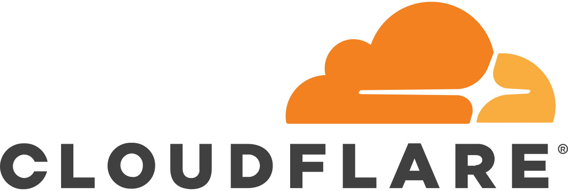

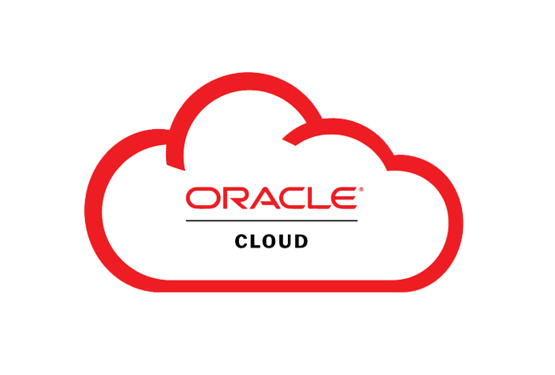
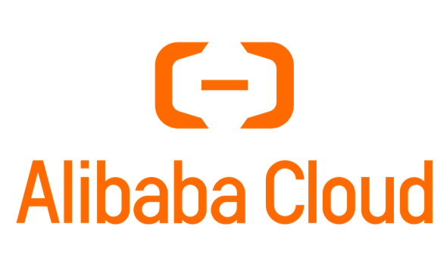

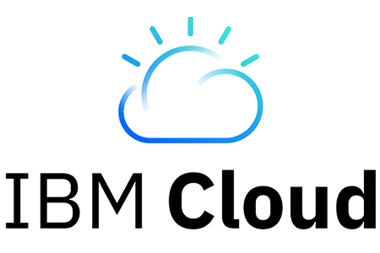


There are more options
Many smaller cloud computing platforms
Notes:
Ask audience what cloud platforms they have used
We have talked about what cloud computing is and why we would want to (or not want to) use it… Now lets look at what are options are for starting out with cloud computing and how we can get started

Slide 49

Questions?
Thanks for joining

